Slide 1
Uncertainty-Aware Machine Learning for Microwave-Based Body Composition Assessment
Master’s Thesis
Student: Abhishek Yadav
Supervisors: Bappaditya Mandal & Robin Augustine
Department of information Technology, Uppsala University

Slide 2
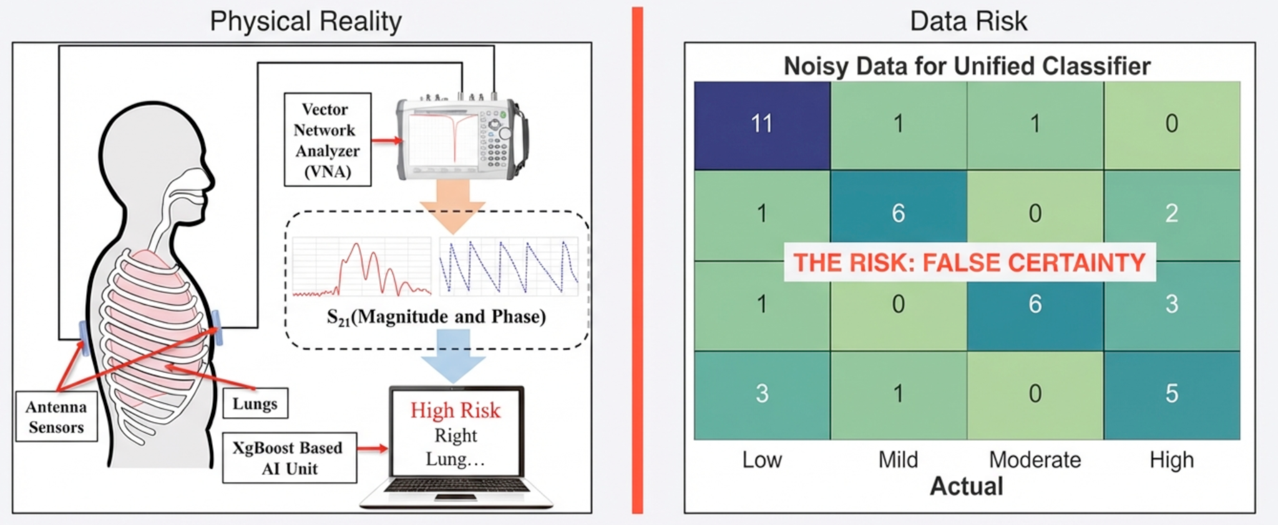
The ‘Trust Gap’ in Clinical Al
Current State: Microwave Sensors + Deterministic XGBoost
The Problem: Point estimates hide model doubt
Clinical Need: System must flag uncertain predictions

Slide 3
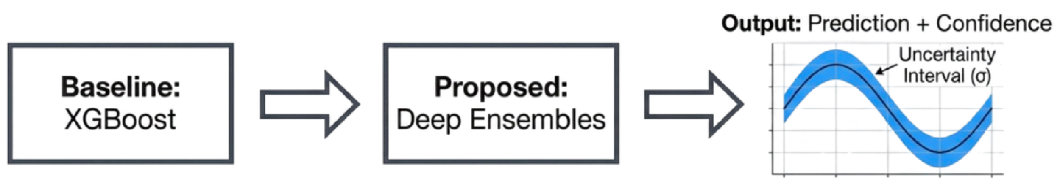
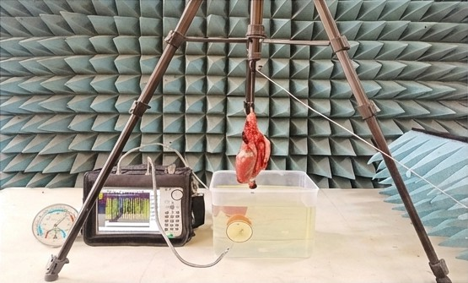
Methodology: From Black Box to Bayesian
Data Sources:
Homogeneous Liquid Phantoms
Ex Vivo Porcine Respiratory Organs
Volunteer Measurements

Slide 4
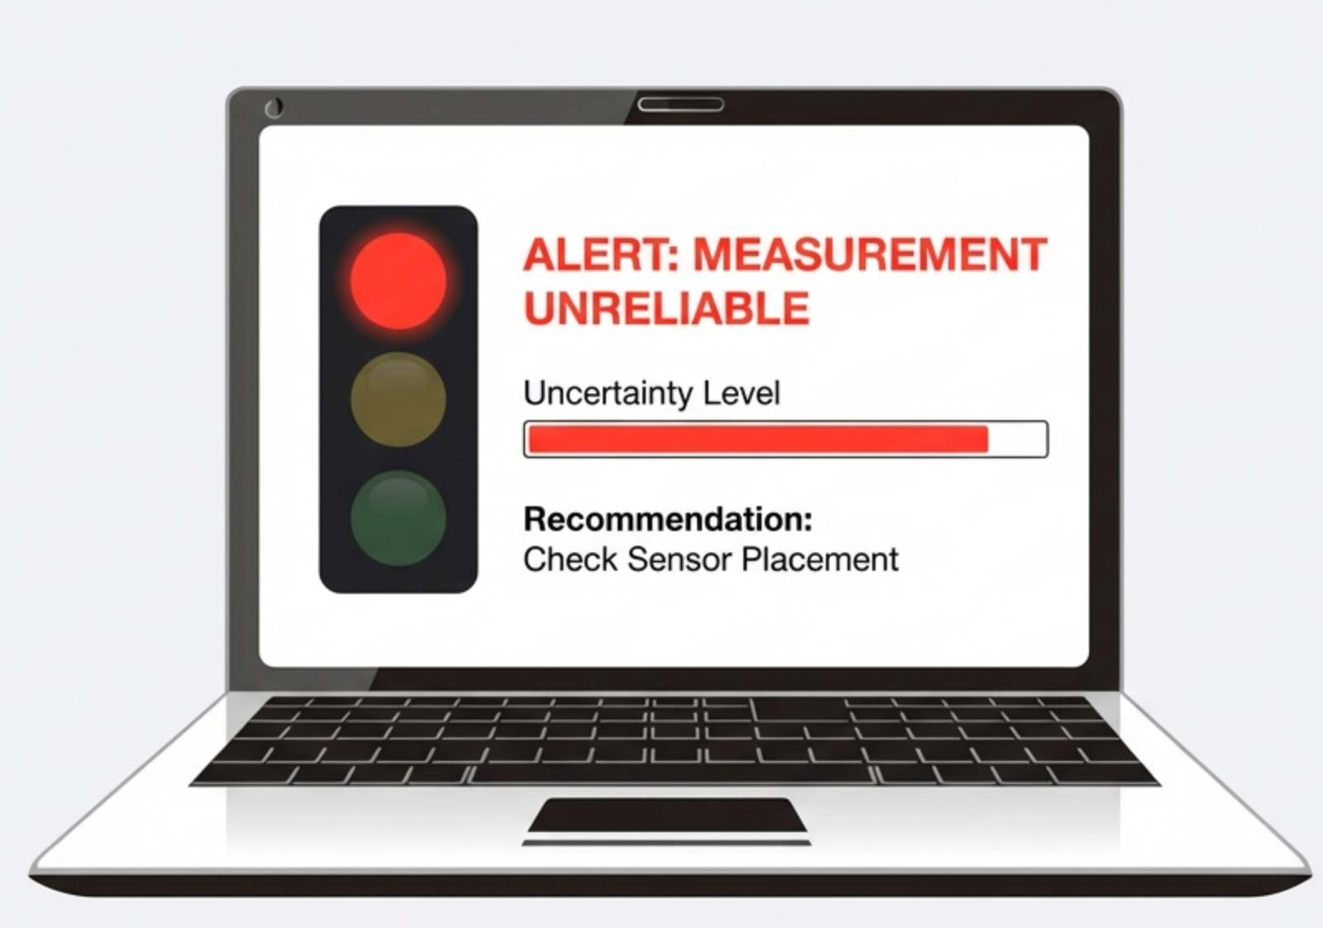
Expected Outcome: Enabling Safe Clinical Translation
Deliverable: Clinical Risk Score.
Mechanism: Automated flags for high uncertainty.
Impact: Bridges the gap between lab capability and patient safety.

